Slide 1
Kernel Synchronization

Slide 2
AGENDA
How the kernel services Requests?
Kernel Preemption & Synchronization
Synchronization Primitives
Synchronization Accesses to Kernel Data Structures

Slide 3
How the kernel services Requests?
Kernel is a waiter who satisfy two types of requests:
Those issued by customers.
Those issued by a limited number of different bosses.
Policy to satisfy requests is:
If a boss calls while the waiter is idle, the waiter starts servicing the boss
If a boss calls while the waiter is servicing a customer, the waiter stops servicing the customer and starts servicing the boss
If a boss calls while the waiter is servicing another boss, the waiter stops servicing the first boss and starts servicing the second one. After finish, he resumes servicing of the former one.
One of the bosses may induce the waiter to leave the customer being currently serviced. After servicing the last request of the bosses, the waiter may decide to drop temporarily his customer and to pick up a new one.

Slide 4
How the kernel services Requests?
Waiter services are performed in Kernel Mode
If CPU is executing in User Mode => Waiter is idle.
Boss Requests: Interrupts
Customer Requests: System calls or exceptions raised by User Mode Process

Slide 5
Kernel Preemption & Synchronization
What is preemptive kernels and non-preemptive kernels?
Both preemptive and non-preemptive kernel: a process running in Kernel Mode can voluntarily relinquish the CPU (For ex: sleep to wait resource) => it is called planned process switch.
In a preemptive kernel, a process running in Kernel Mode reacts to asynchronous events that could induce a process switch => forced process switch.
Both preemptive and non-preemptive kernel: a process switch occurs when a process has finished some thread of kernel activity and the scheduler is invoked.
In non-preemptive kernel, the current process cannot be replaced unless it is about to switch to User Mode.

Slide 6
Kernel Preemption & Synchronization
Main characteristic and motivation of a preemptive kernel :
A process running in Kernel Mode can be replaced by another process while the middle of a kernel function.
Benefit for processes performing timely scheduled tasks (such as external hardware controllers, movie-players, environmental monitors …)
For example: if on a particular CPU there are two tasks available, and one takes a syscall that takes 5ms to complete, and the other is an MP3 player application that needs to feed the audio pipe every 2ms, you might hear stuttering audio.

Slide 7
Kernel Preemption & Synchronization
When synchronization is necessary?
Race condition: When the outcome of a computation depends on how two or more processes are scheduled, the code is incorrect.
Critical region: Any section of code that should be finished by each process that begins it before another process can enter it (cause race condition)

Slide 8
Kernel Preemption & Synchronization
When synchronization is not necessary?
Recall some designs:
All interrupt handlers acknowledge the interrupt and also disable the IRQ line. Further occurrences of the same interrupt cannot occur until the handler terminates.
Interrupt handlers, softirqs and tasklets are both non-preemption and non-blocking,
A kernel control path performing interrupt handling cannot be interrupted by a kernel control path executing a deferrable function or a system call service routine.
Softirqs and tasklets cannot be interleaved on a given CPU.
The same tasklet cannot be executed simultaneously on several CPUs.

Slide 9
Kernel Preemption & Synchronization
When synchronization is not necessary?
Per CPU variables accessed by softirqs and tasklets only do not require synchronization.
A data structure accessed by only one kind of tasklet does not require synchronization.

Slide 10
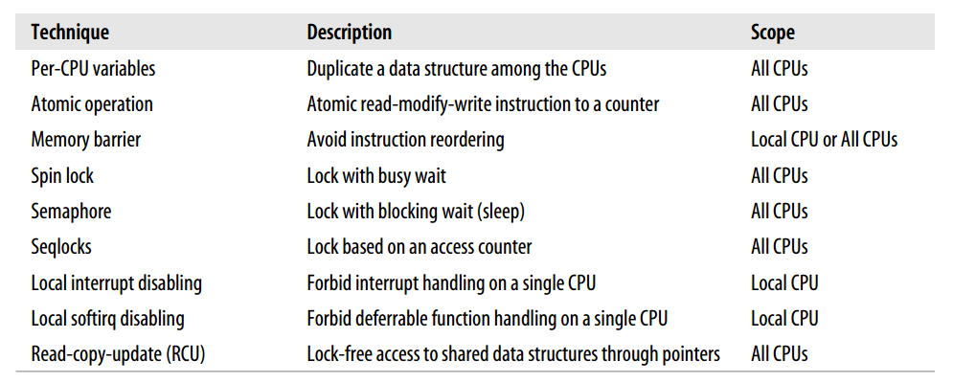
Synchronization Primitives

Slide 11
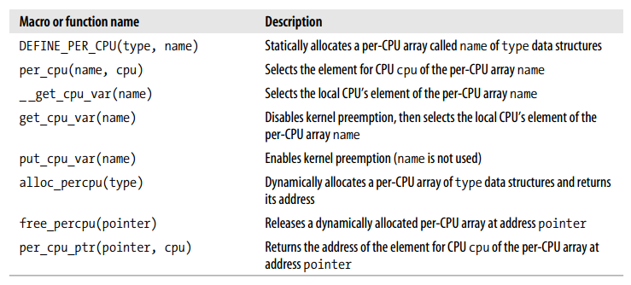
Synchronization Primitives: Per-CPU Variables
Notes:
per-CPU variables only provide protection between several CPUs, but do not provide protection between asynchronous functions (interrupt handler or deferrable functions).

Slide 12
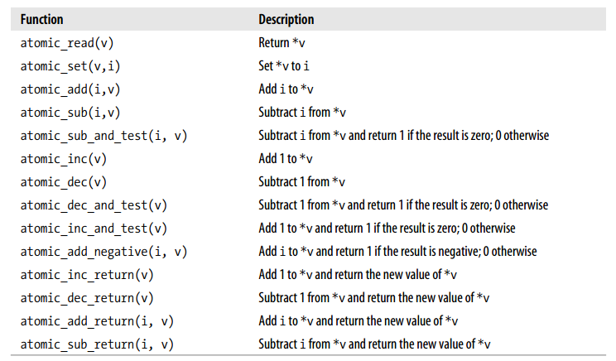
Synchronization Primitives: Atomic Operations
Notes:
To prevent race conditions due to “read-modify-write” instructions is by ensuring that such operations are atomic at chip level.

Slide 13
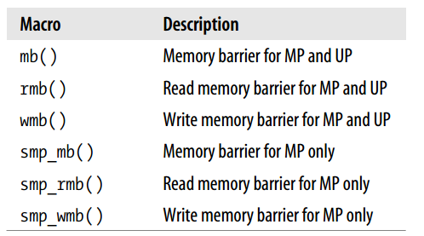
Optimization and Memory Barriers
You should never take for granted that instructions will be performed in the exact order in which they appear in the source code.
Compiler problems
A memory barriers primitive ensures that the operations placed before the primitive are finished before starting the operations placed after the primitive.

Slide 14
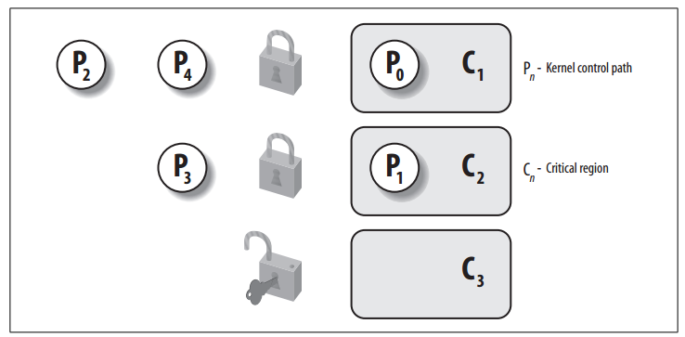
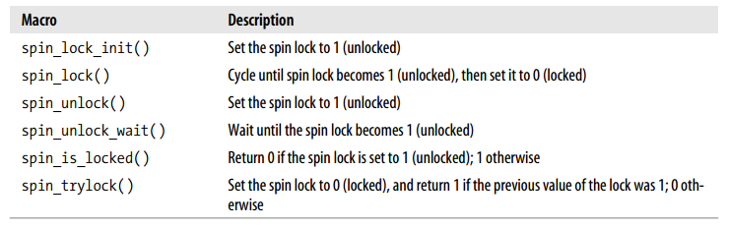
Synchronization Primitives: Spin Locks

Slide 15
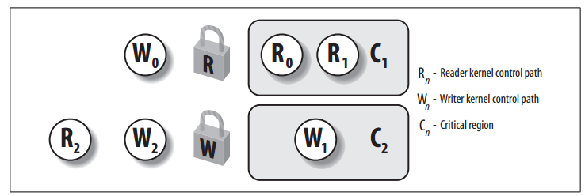
Synchronization Primitives: Read/Write Spin Locks
Notes:
Structure: rwlock_t

Slide 16
Synchronization Primitives: Seqlocks
Structure: seqlock_t
Using read/write spin locks, requests have the same priority.
Seqlocks give a much higher priority to writers: in fact, a writer is allowed to proceed even when readers are active.

Slide 17
Synchronization Primitives: Read-Copy Update (RCU)
RCU allows many readers and writers to proceed concurrently (an improvement over seqlocks).
How does RCU do?
Only data structures that are dynamically allocated and referenced by means of pointers can be protected by RCU.
No kernel control path can sleep inside a critical region protected by RCU.
Reader does very litter to prevent race conditions => writer has to do it.

Slide 18
Synchronization Primitives: Read-Copy Update (RCU)
How writer prevents race conditions?
When the writer wants to update data structure, it will:
It dereferences the pointer and makes a copy of the whole data structure.
Write the modifies the copy
Once finished, the writer changes the pointer to the data structure so as to make it point to the updated copy
Problem: The old copy of the data structure cannot be freed right away when the writer updates the pointer. The old copy can be freed only after all (potential) readers on the CPUs have executed the rcu_read_unlock() macro.

Slide 19
Synchronization Primitives: Semaphores
A kernel semaphore is similar to a spin lock.
However, whenever a kernel control path tries to acquire a busy resource protected by a kernel semaphore, the corresponding process is suspended.
It becomes runnable again when the resource is released. Therefore, kernel semaphores can be acquired only by functions that are allowed to sleep.
Interrupt handlers and deferrable functions cannot use them

Slide 20
Synchronization Accesses to Kernel Data Structures
The following rule of thumb is adopted by kernel developers:
“Always keep the concurrency level as much as possible”
In turn, the concurrency level in the system depends on two main factors:
The number of I/O devices that operate concurrently: To maximize I/O throughput, interrupts should be disabled for very short periods of time
The number of CPUs that do productive work: To use CPUs efficiently, synchronization primitives based on spin locks should be avoided whenever possible

Slide 21
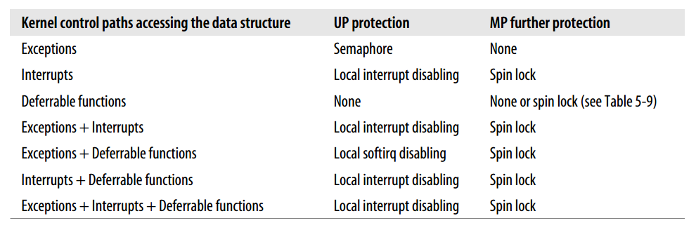
Synchronization Accesses to Kernel Data Structures

Slide 22
summary

Slide 23
reference
Understanding the Linux Kernel, 3rd Edition - O'Reilly Media

Slide 24

Thank you

